Slide 1
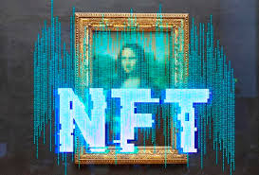
Minting and Printing NFT Certificates: ~Proof of Competency~
Justin Leffew - Jeffrey Brinker - Ameira Khaleq

Slide 2



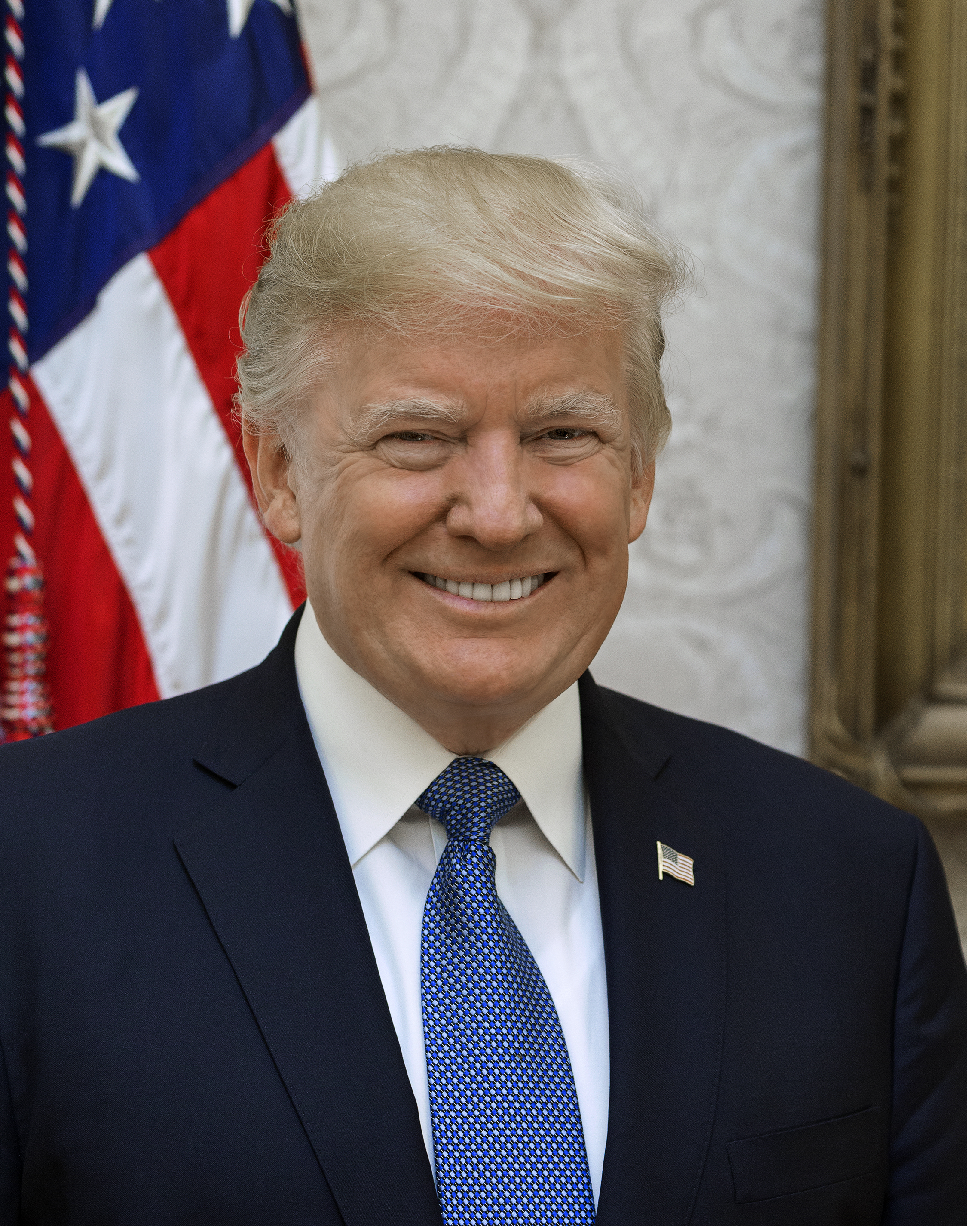




Background
One of the biggest problems in the world today is misinformation and disinformation. Whether it be Twitter, Facebook, TikTok, Truth Social, or any other social media app, everyone can have a voice in the public square.
Every single news network plays to their audience. Clicks drive revenue and outrageous takes get more clicks.
While freedom of speech is/should be an unalienable right, all speech does not deserve to be heard by everyone. All speech is not equal. All people are not equal.
Can the real experts please stand up?
Notes:
Look at you – everyone watching this presentation is a better Python/Web3 programmer than you were prior to this class. Who would you rather take Python advise from, you from 6 months ago or you today?

Slide 3

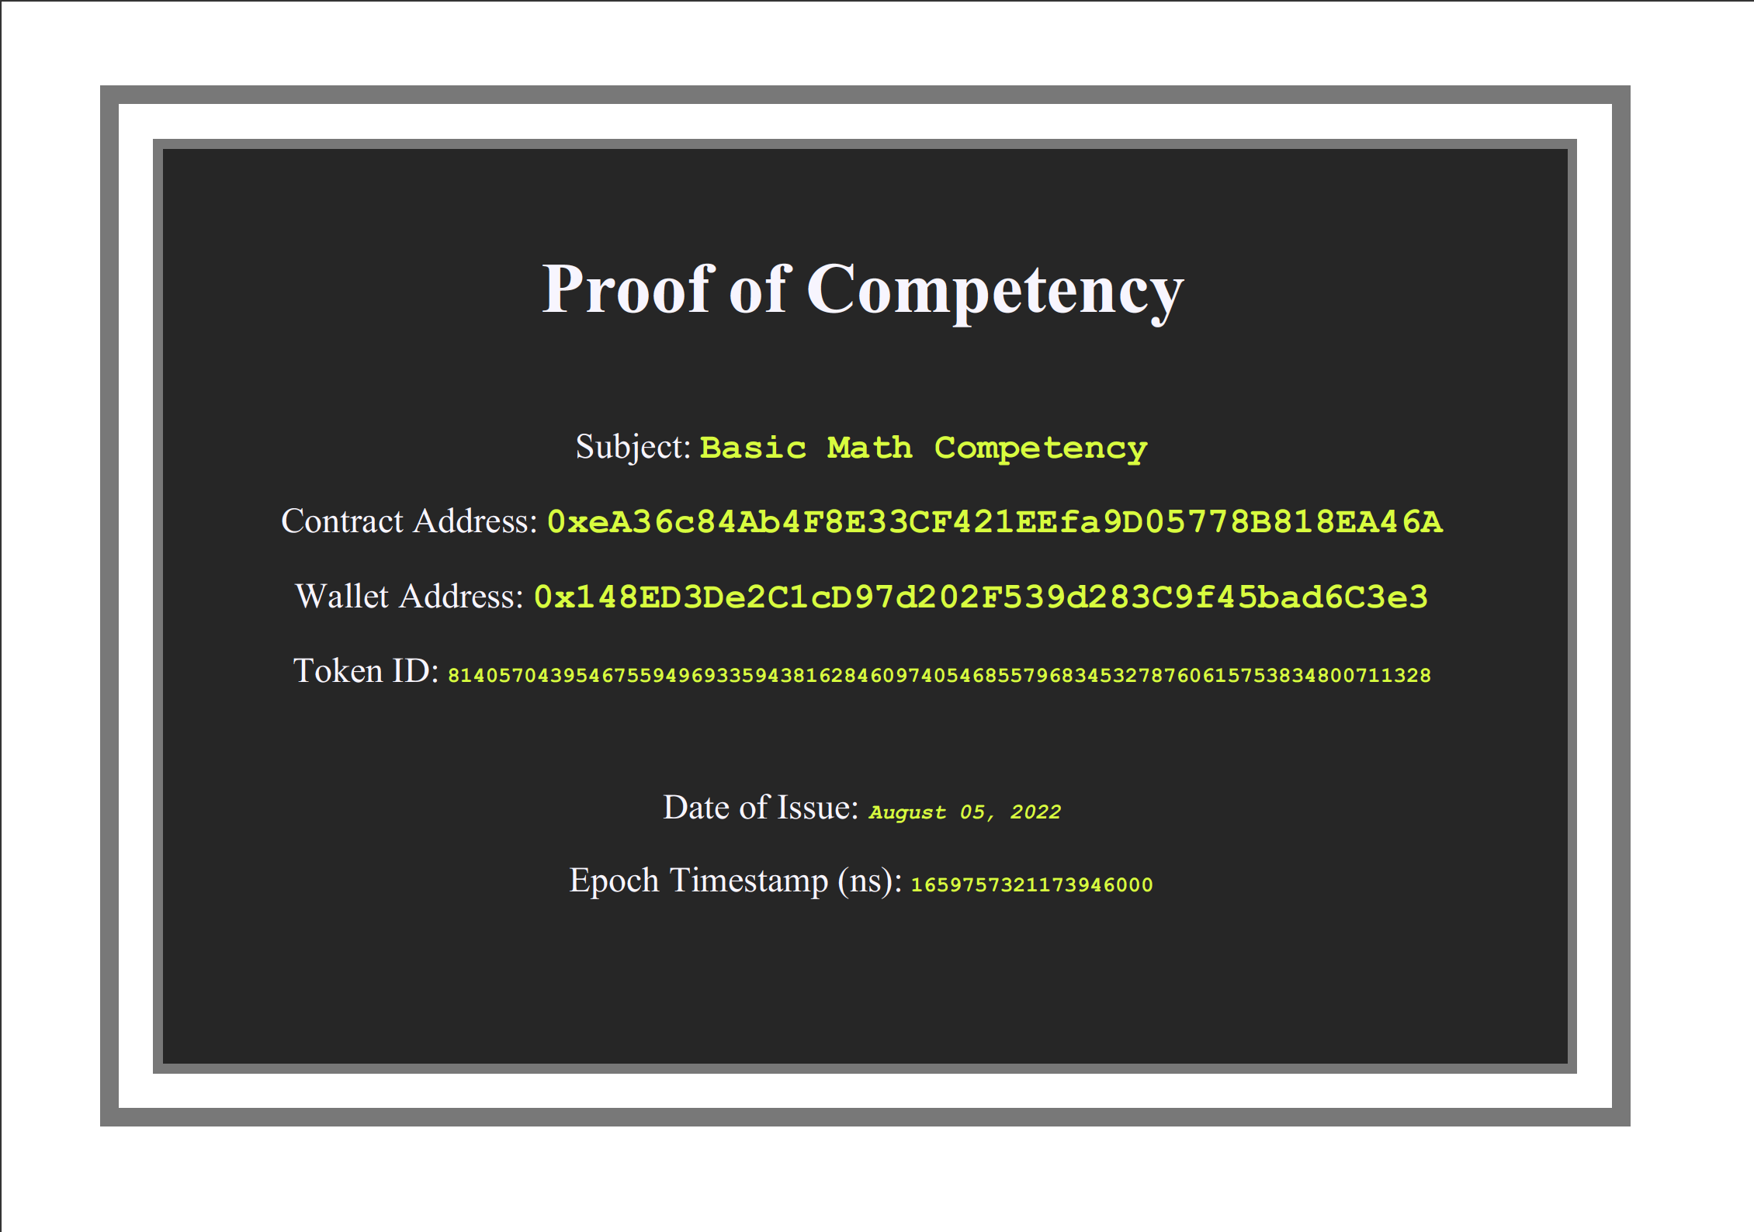

Slide 4

Proof Of Concept
We envision a world where instead of seeing posts and comments from everyone, users can filter them and only see information from those who have verifiable expertise in the subject being discussed. If someone wants to be able to contribute to the public conversation about a certain topic, they must show they have a minimum acquired knowledge.
As a proof of concept, once a user passes a test created by an “expert”, an ERC721 NFT will be minted and passed to their wallet. This will be a key that will give them access to read & write within certain forums. Users without a valid NFT Certificate will have read-only access to said forum. Users can be pseudonymous while also being trusted experts, depending on the number and quality of NFTs. NFTs are tied to public addresses, visible to all, and non-transferrable. They can be minted or burned only.

Slide 5
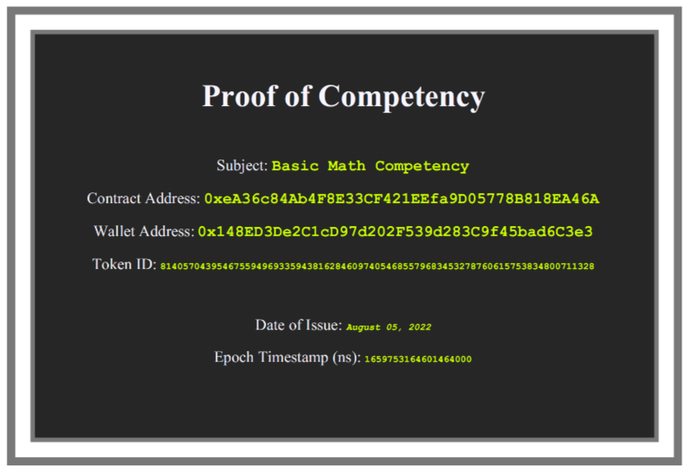
Minimum Viable Product (MVP)
A user submits answers to a short test
The submission will be checked against an answer key
User can mint an NFT tied to their wallet address. (if passing)
NFT grants access to NFT gated website
A user without the required “proof of competency” NFT will have read-only access.

Slide 6
Test & Certificate Demo

Slide 7
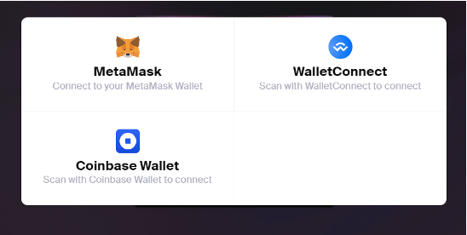
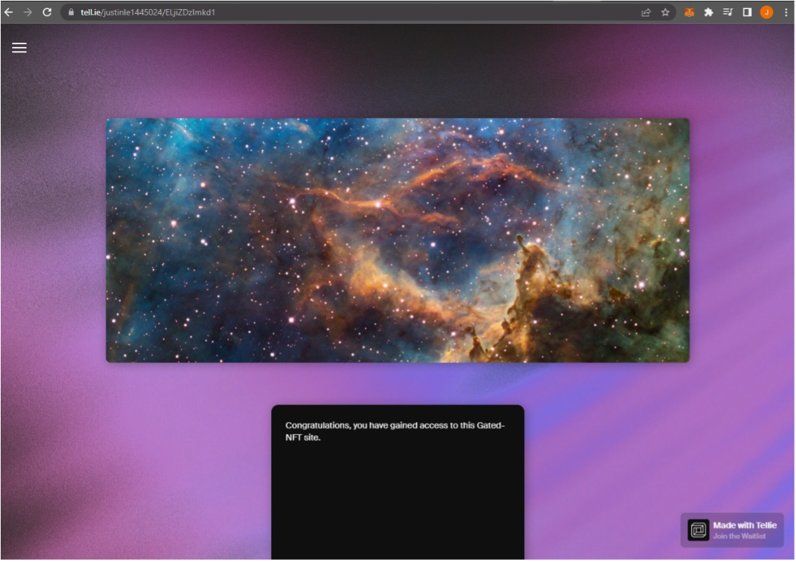
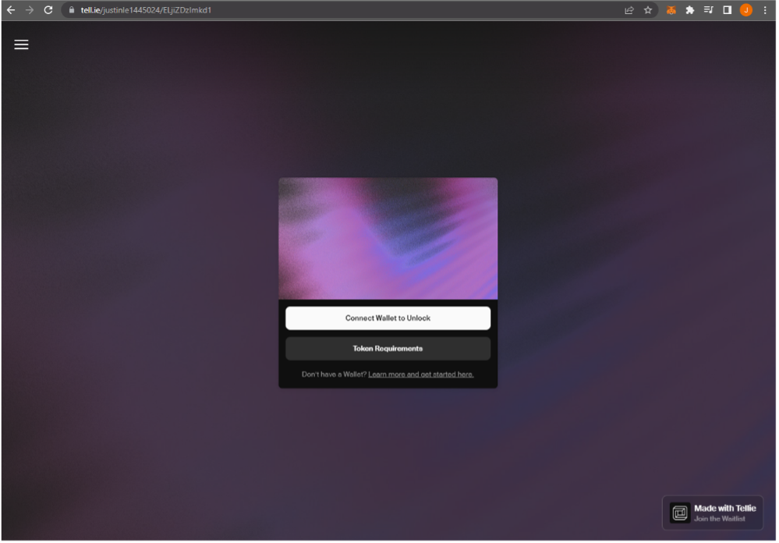

USER EXPERIENCE
STEP 1: Obtain Website URL
STEP 2: Click connect wallet and select hot wallet where the NFT is stored
STEP 3: If wallet has the required NFT, access to the website is granted.

Slide 8
Resources & Additional Features
Systems used
Additional features (future)
Remix
Ganache
Streamlit
Tell.ie
Ethereum wallet (Metamask, Coinbase Wallet)
OpenSea - Initial Imports and Environment tools (pending development)
A forum to read from/write to
Write only with valid NFT certificate
Print/download the NFT as a pdf.
Image/Design on the pdf (visually catchy)
Easy way to create tests

Slide 9
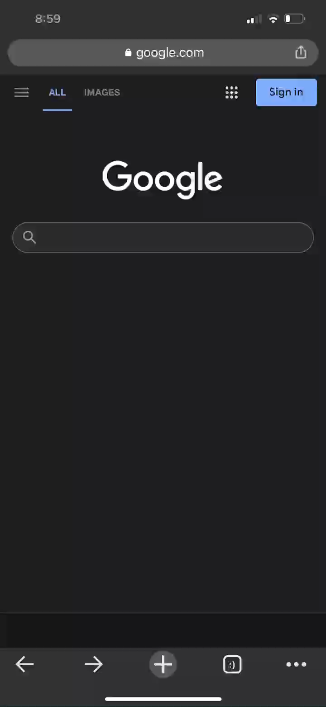
NFT-Gated Website Access Demo

